Slide 1
Introduction to AI
Hong Qin, U of Tennessee Chattanooga,
May 23, 2024

Slide 2
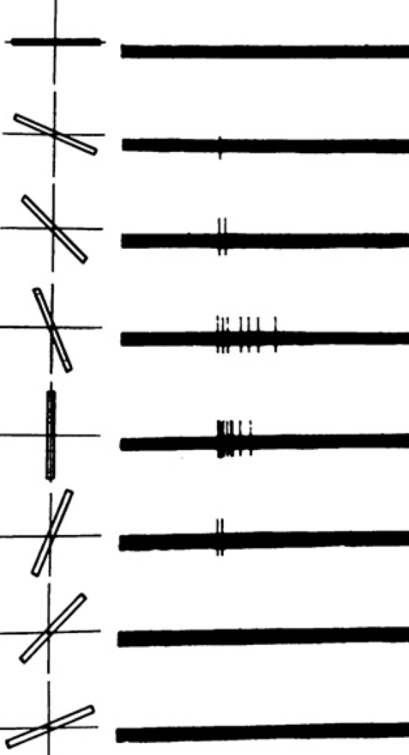
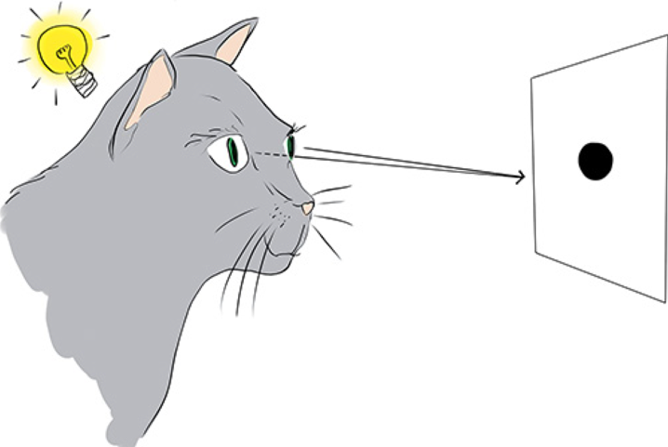
How do brains work?
A Simple Neuron Recognizes a Feature
Krohn et al, Deep Learning Illustrated, 2020

Slide 3
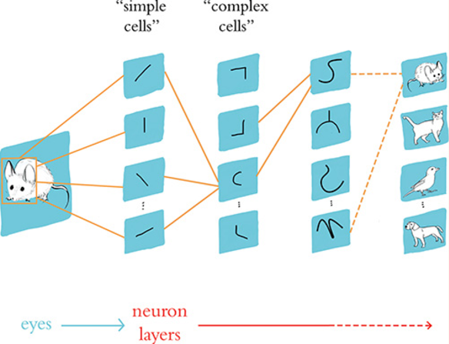
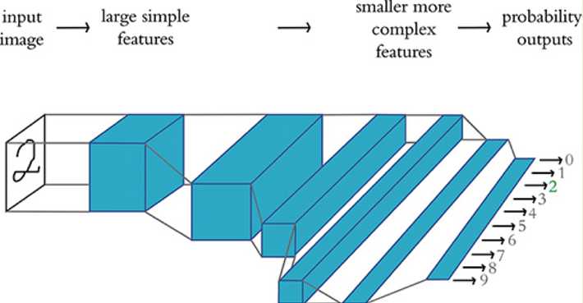
From Brains to Neural Networks
Krohn et al, Deep Learning Illustrated, 2020

Slide 4
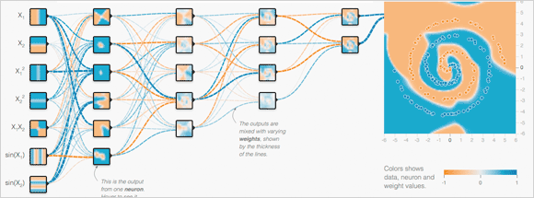
Neural Network Playground
https://playground.tensorflow.org/
Learning Objectives:
Features
Number of layers
Number of neurons
Loss function
Activation function.
Learning rate
Epoch
Regularization
Notes:
Penalty for more complicated models, addressing overfitting.
1 Two circles
1.1: two circles, 1 hidden layer, 2 neurons; 2 output neuron
1.2: 3 hidden neurons, 1 output neurons (not working)
1.3 3 hidden neurons; 2 output neuron (worked)
2. Spirals
2.1: 2 input neuron; 1 hidden layer, 2 neuron, (1, 2) output neuron. Terrible
2.1: 4 input neuron; 1 hidden layer, (3,4,5,6)neuron, (2,3,4) output neuron. Modest improvement
2.2 2 hidden layers with 2 neuron
2.3 5 input neurons, 8 x8 x 4 neurons; 2 output neurons worked.

Slide 5
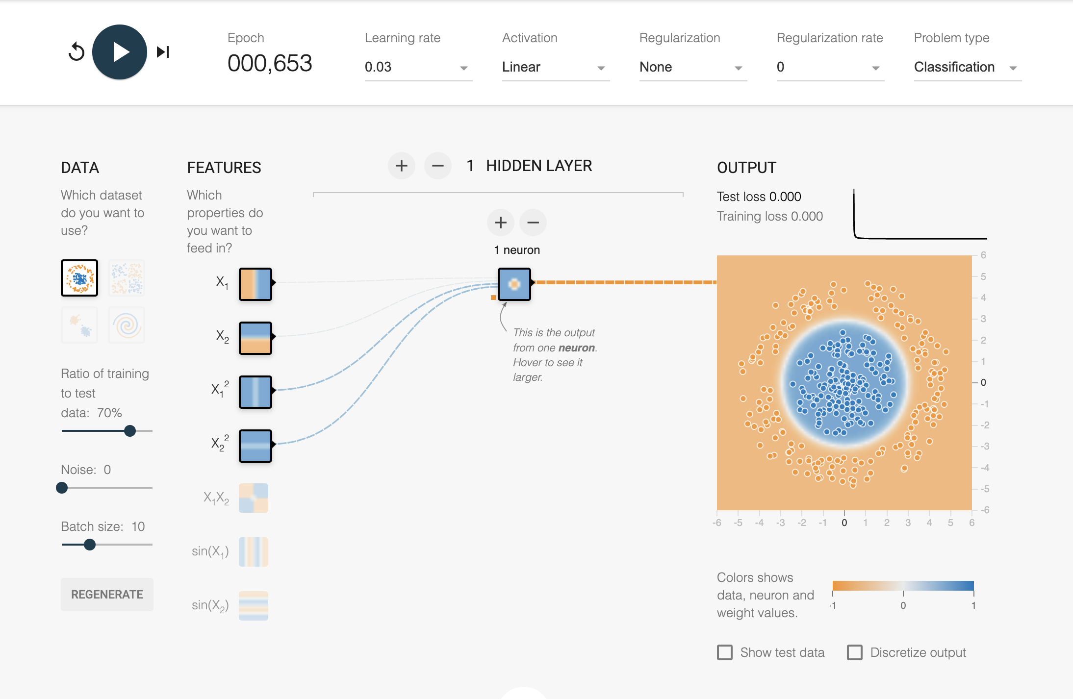
Linear Models in Simple Cases

Slide 6
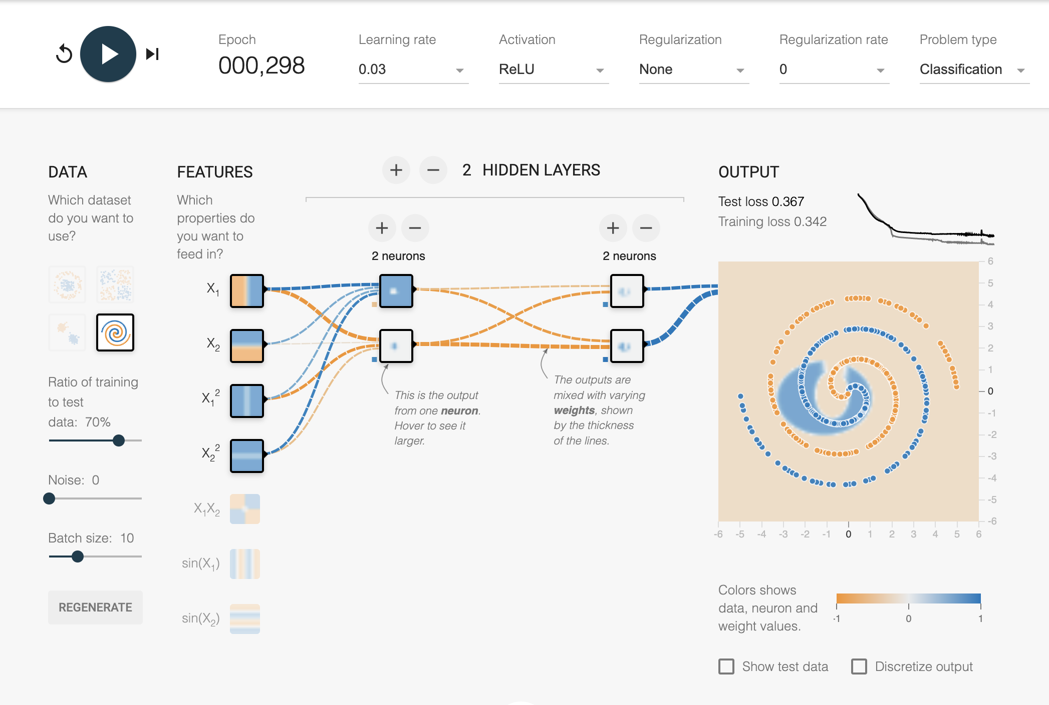
Linear Models in Challenging Cases

Slide 7
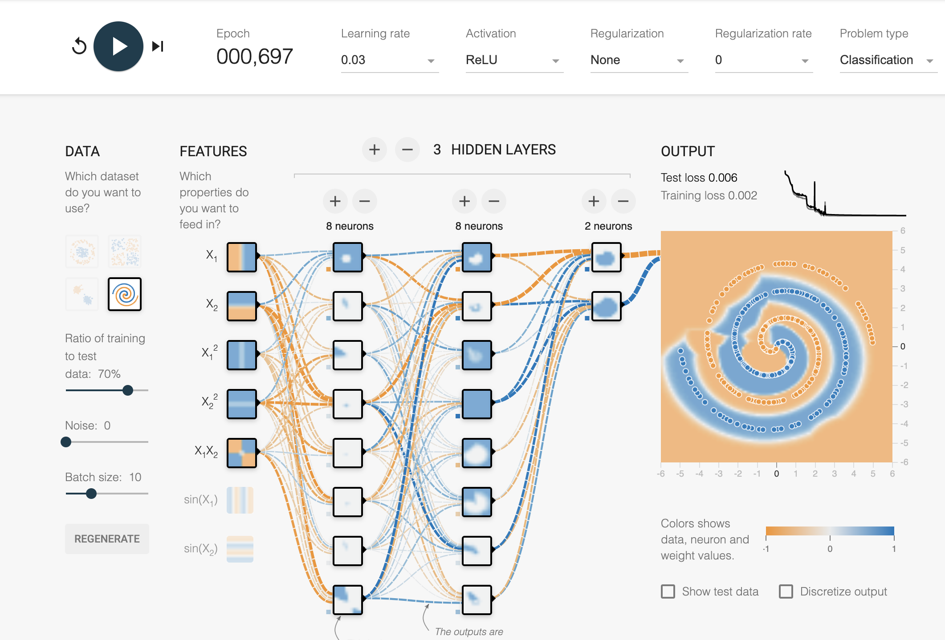
Deep Models Work!
Notes:
Recap the key parameters

Slide 8
Features Number of layers Number of neurons Loss function Activation function. Learning rate Epoch Regularization
Quick Summary
Notes:
Recap the key parameters

Slide 9
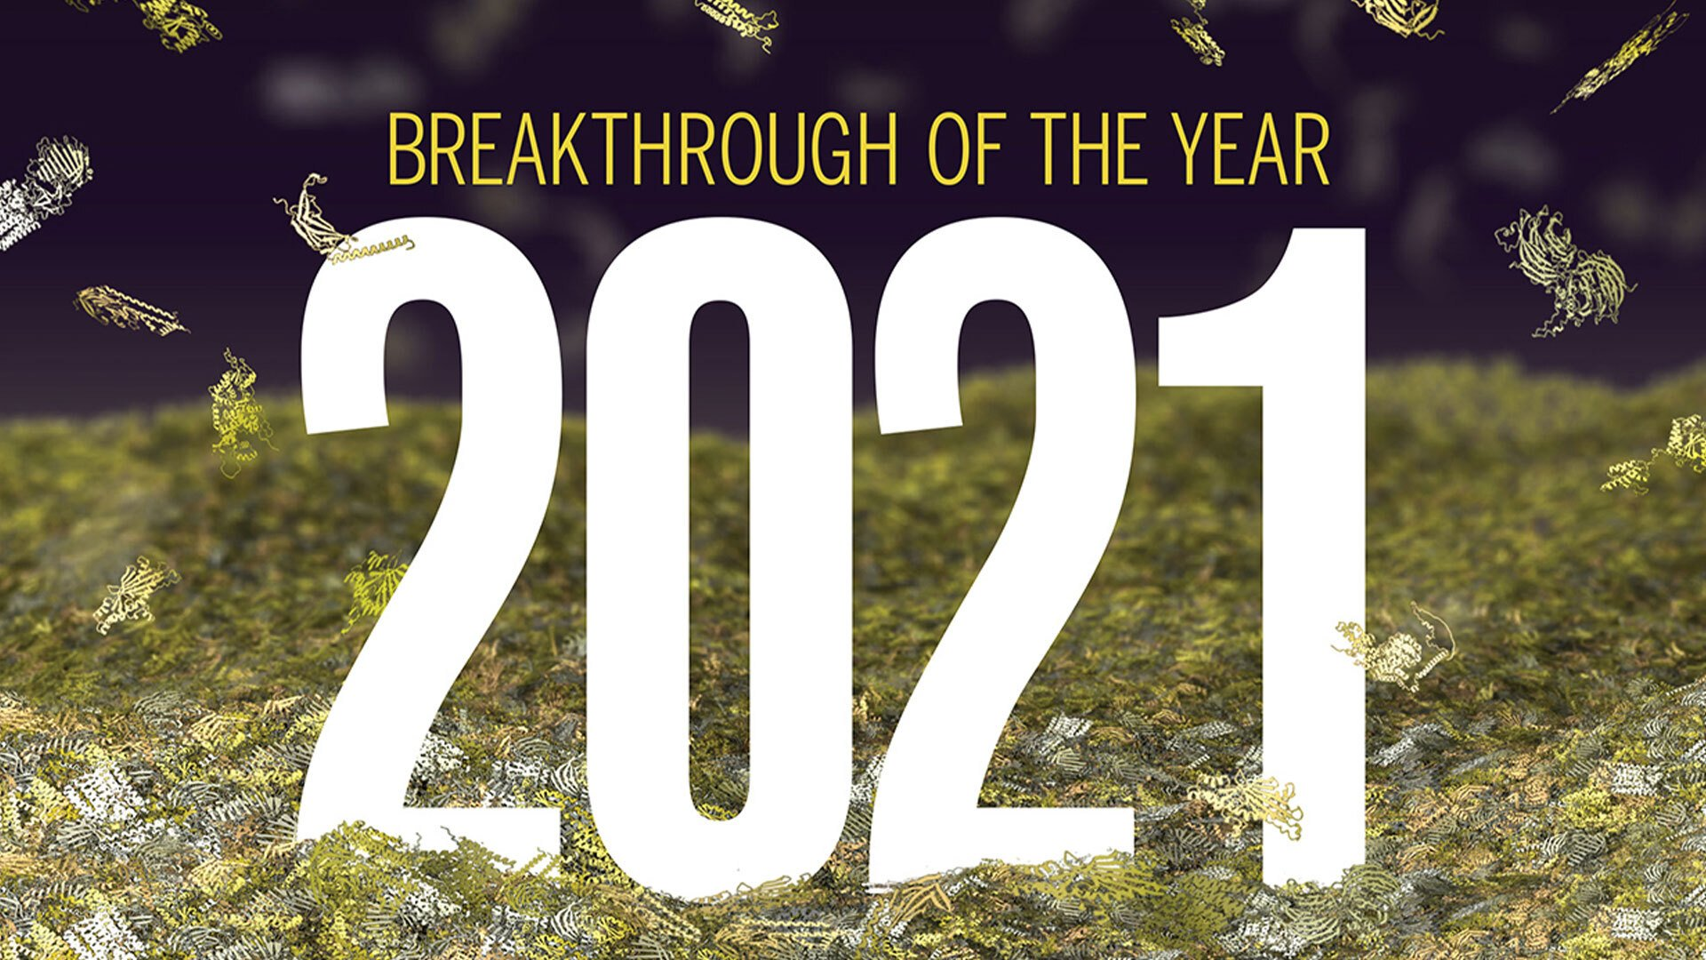
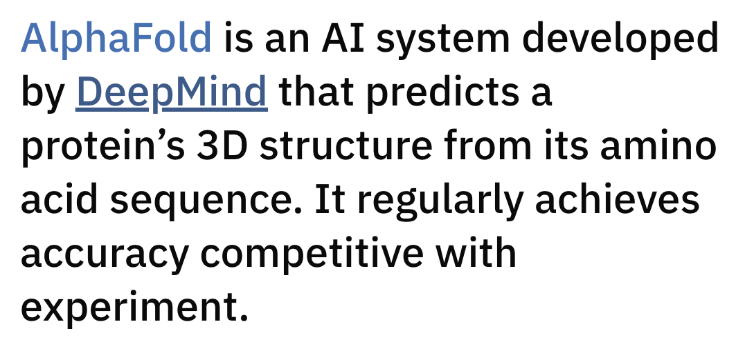
Recent AI advances in biomedical fields
Biomedical Image Analysis – Automation.
Protein 3D Structure Prediction.
https://www.science.org/content/article/breakthrough-2021
Notes:
https://www.science.org/content/article/breakthrough-2021

Slide 10
Add more on AlphFold

Slide 11
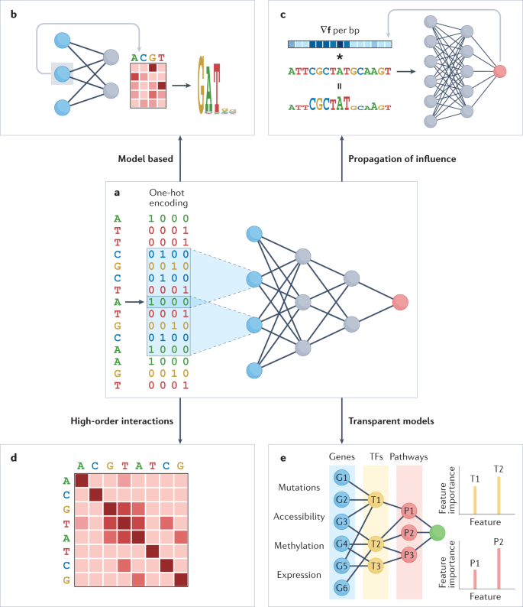
Some Trends of Machine Intelligence in Biomedical Fields
Explainable AI (XAI)
Prediction and Personalization
Privacy-preserved AI
Trustworthy AI
Large Language Models
Novakovsky, et al. Nat Rev Genet (2022).

Slide 12




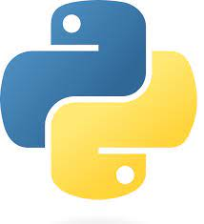
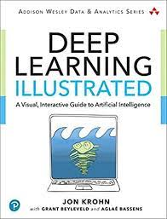



To Learn Machine Intelligence
Python, Notebooks
CoLab – Cloud working space
Code depositories
chatGPT

Slide 13
Add more on large language models in bioinformatics

Slide 14
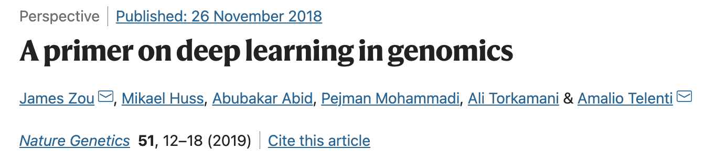
A CoLab Tutorial on Deep Learning with DNA
https://github.com/hongqin/Python-CoLab-bootcamp/blob/master/A_Primer_on_Deep_Learning_in_Genomics_Public.ipynb
Notes:
https://colab.research.google.com/drive/17E4h5aAOioh5DiTo7MZg4hpL6Z_0FyWr
https://github.com/hongqin/Python-CoLab-bootcamp/blob/master/A_Primer_on_Deep_Learning_in_Genomics_Public.ipynb

Slide 15
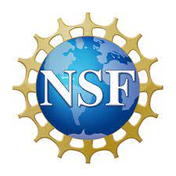


Acknowledgment
National Science Foundation
National Academy of Medicine
University of Tennessee at Chattanooga
Deep learning illustrated
https://playground.tensorflow.org/
https://www.science.org/content/article/breakthrough-2021
https://alphafold.ebi.ac.uk/
Novakovsky, et al. Nat Rev Genet (2022).
Zou, J.,et al. Nat Genet 51, 12–18 (2019).

